Slide 1
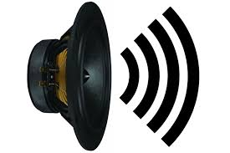


USB 2.0 UAC (USB Audio Class) to I2S Audio Demo Block Diagram
GOWIN FPGA
I2S Controller
Buffer
Post- Processing
Amplifier
UAC
USB 2.0

Slide 2
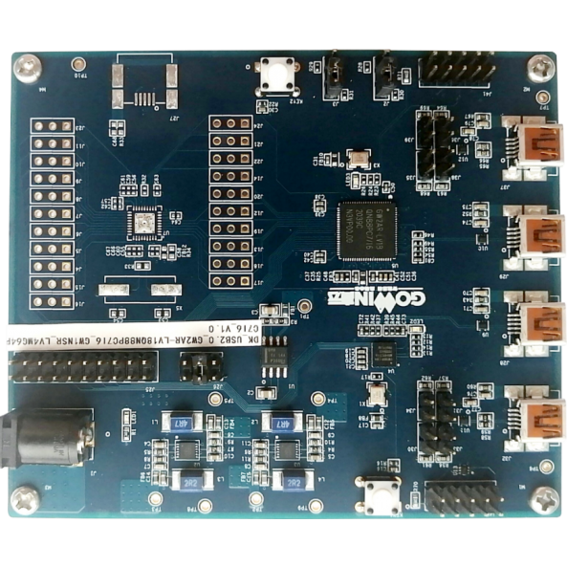
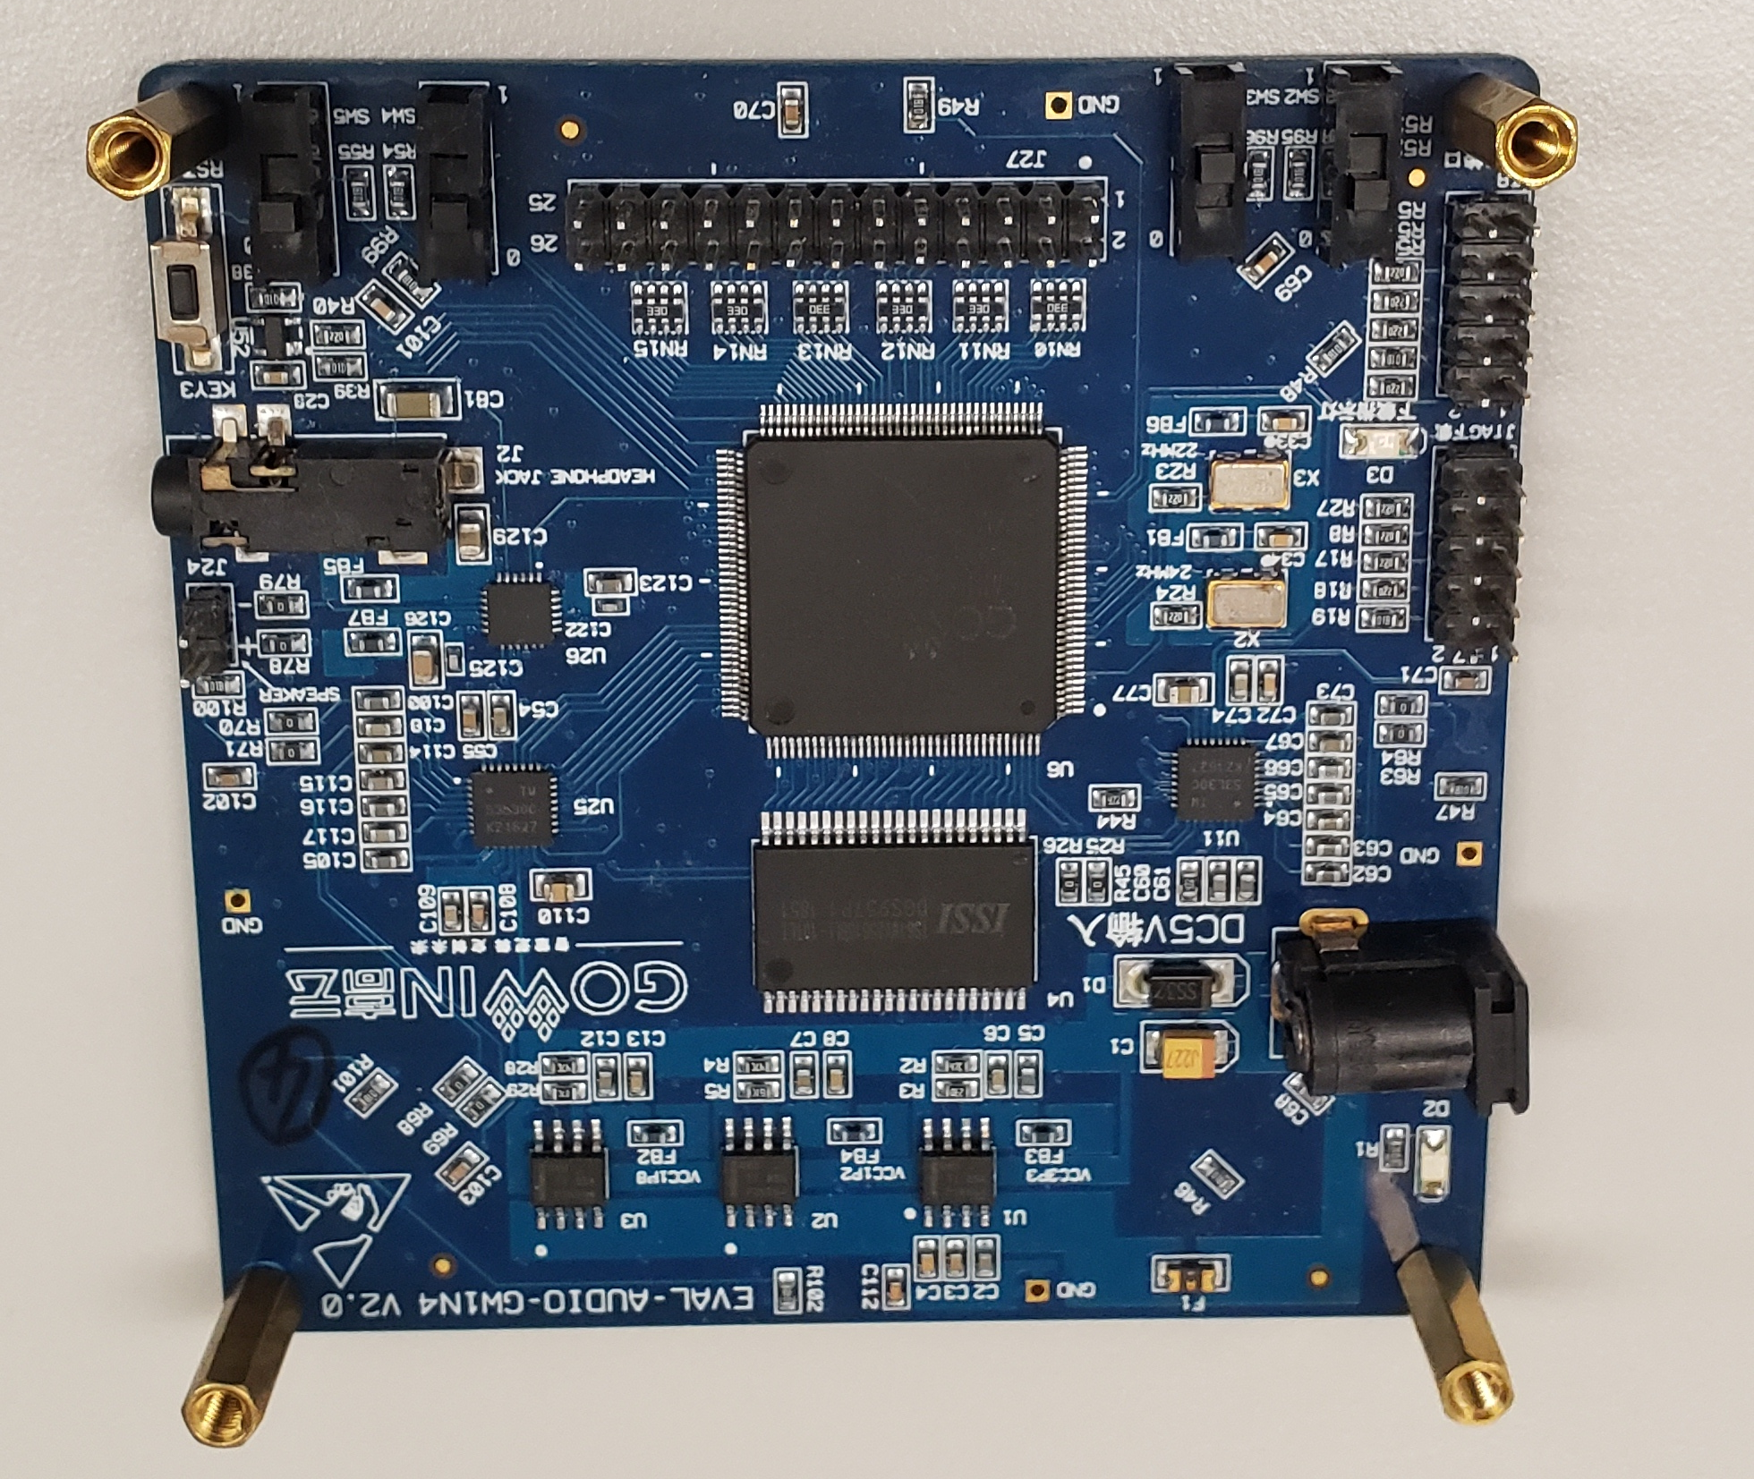

USB 2.0 UAC (USB Audio Class) to I2S Audio Demo Hardware Setup
I2S
Device shows up as Audio Card on PC
DK-USB 2.0 Development Board
Audio Amplifier Board
5V Power Supply

